Slide 1

PROJECT MEMBERS: AKASH ZALKE (4) ADWAIT PADHYE (3) ANIK MUKHERJEE (7) -Leader HIMANSHI DARVEKAR (21)
GOVERNMENT COLLEGE OF ENGINEERING NAGPUR
1

Slide 2
COLOR MATRIX BASED VIRTUAL PASSWORD SYSTEM
2

Slide 3
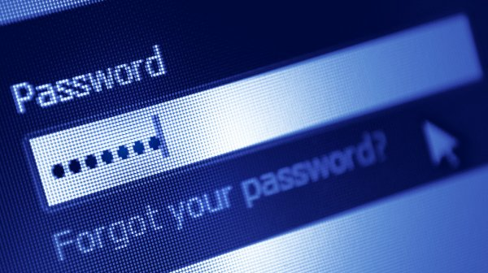
PROBLEM STATEMENT
Today’s information system the security is largely supported by password for authentication process .
The most of password contains alphanumeric and special characters it is highly vulnerable.
To overcome the drawbacks of traditional method we propose new authentication method to tackle well known Security threats like brute force, dictionary attacks phishing attacks and spyware attacks.

Slide 4
PROBLEM EXPLANATION
In today's high technology environment, organizations are becoming more and more dependent on their information systems.
The public is increasingly concerned about the proper use of information, particularly personal data. The threats to information systems from criminals and terrorists are increasing.
Today’s information system the security is largely supported by password for authentication process.The most of password contains alphanumeric and special characters it is highly vulnerable. To overcome the drawbacks of traditional method we propose new authentication method to abolish well known Security threats like brute force, dictionary attacks, shoulder surfing, phishing attacks and spyware attacks.

Slide 5

PROBLEMS WITH EXISTING SYSTEM
Encryption is a process of changing the data into unreadable format, much of the data flows through information system is highly sensitive need to be protected, and the disadvantage of widely used encryptions method are that they are vulnerable when the user is entering the actual password and hackers can easily get hold of the password even before the password gets encrypted , such attacks are Phishing attack , Keylogger attack and also Shoulder surfing.
Studies have shown that most malware does not harm computers but collect data from the systems, this data comprise of keylogging activities and monitoring password and username fields.

Slide 6
PROPOSED MODEL
To overcome the drawbacks of the present password systems, we are presenting a robust password scheme, which is multi-platform and easily adaptable for traditional personal computers, smart phones and web applications.
In our model user will be authenticated in following steps whenever logging in:.
Step 1: User enters his username.
Step 2: A color grid will be displayed with alphanumeric characters mapped with some color.
Step 3: Now user will enter the first letter of the background color of grid in which his actual passwords
letter lies.
Step 4: In this step authentication of the password will be done on server side by verifying the background ...………….color of the box with given authentication key. After refreshing, the virtual password expires which ……………. means the background color of boxes of grid changes randomly.
For every login attempt the background color of boxes in grid will be changed. As the user uses color codem matrix password system it is impossible for hacker to intrude into system or know
the original password using the virtual password.

Slide 7
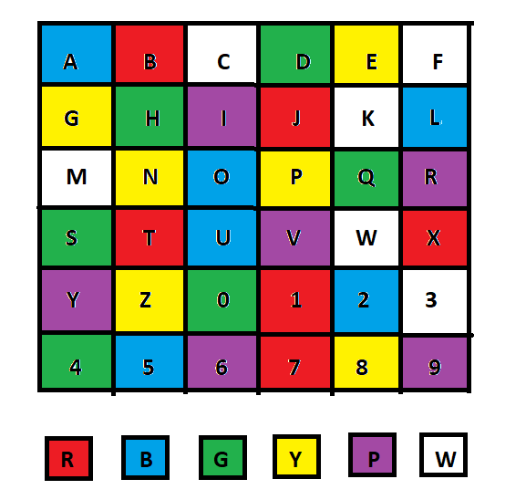
PROPOSED MODEL
Example:
Suppose user’s actual password is ‘Hello’ but he’s not going to use his actual password as ‘Hello’ instead as you can see a color grid on right side so accordingly the user will enter ‘GYBBB’ as his virtual password here:
‘G’ stands for ‘Green color’ which is mapped to letter ‘H’
‘Y’ stands for ‘Yellow color’ which is mapped to letter ‘E’
‘B’ stands for ‘Blue color’ which is mapped to letter ‘L’
‘B’ stands for ‘Blue color’ which is mapped to letter ‘L’
‘B’ stands for ‘Blue color’ which is mapped to letter ‘O’
Since single color can be mapped to more than one letter its not possible for hacker to get exact password even through shoulder surfing or keylogger attacks. Also, the color mapping changes on refresh or each login attempts.
Password: HELLO
Virtual Password Entered:
GYBBB

Slide 8
MODULES TO DESIGN
USER INTERFACE
VIRTUAL PASSWORD MAPPING
KEY GENERATION AT SERVER
AUTHENTICATION
(MATCHING KEY WITH VIRTUAL PASSWORD)

Slide 9
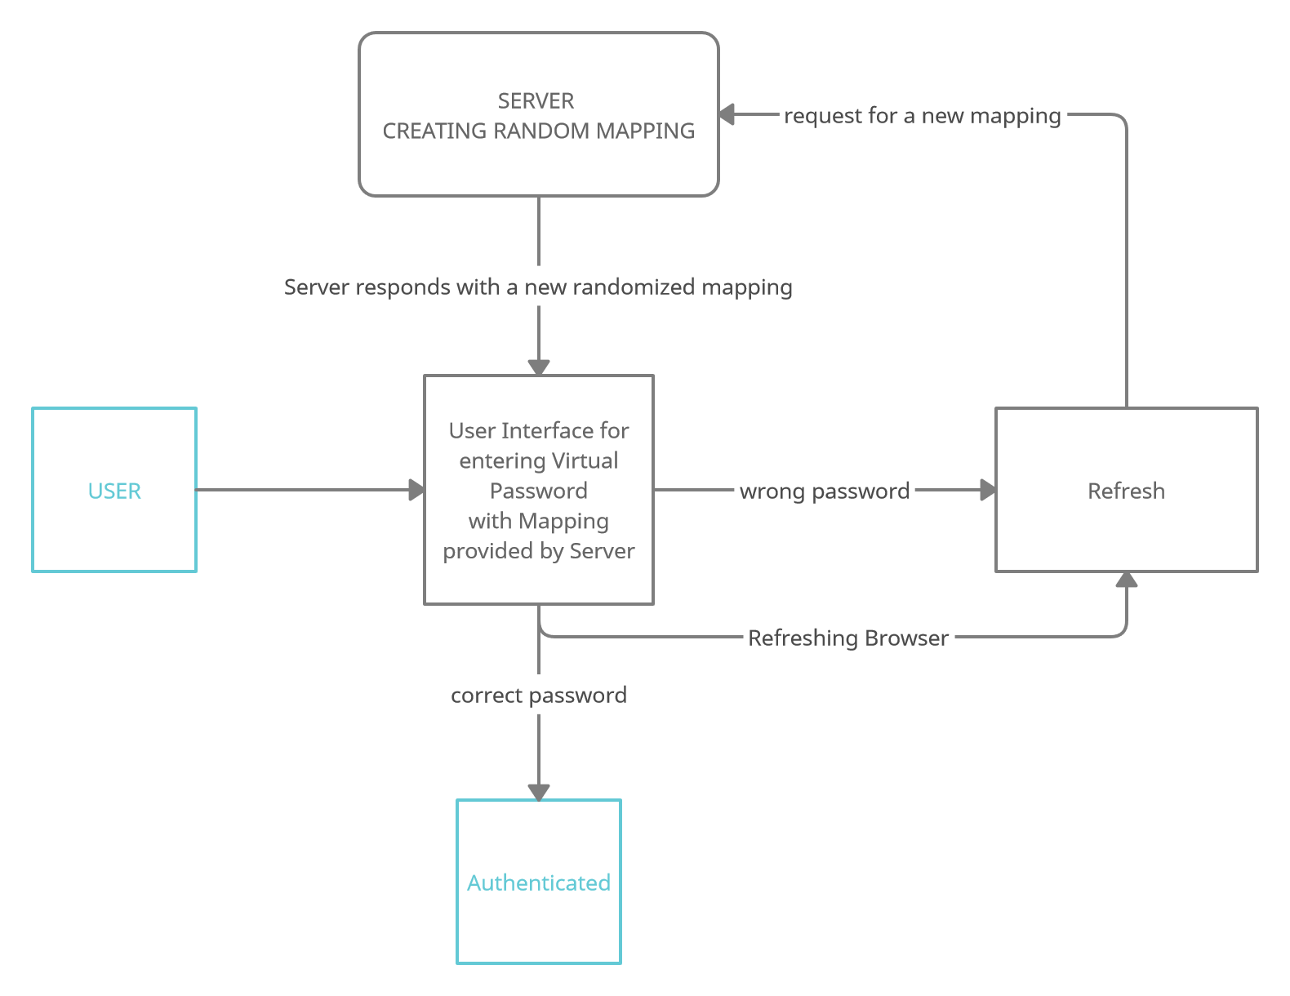
DATA FLOW DIAGRAM

Slide 10
BENEFITED MULTITUDE
Alphanumeric passwords are widely used in computer and network authentication to protect users' privacy. However, it is well known that long, text-based passwords are hard for people to remember, while shorter ones are susceptible to attack.
Graphical password is a promising solution to this problem in all password based systems.
Shoulder-surfing is a known risk where an attacker can capture a password by direct observation or by recording the authentication session. Due to the visual interface, this problem has become exacerbated in graphical passwords.

Slide 11
TECHNOLOGIES REQUIRED
Hardware Requirements:
Android/IOS/Windows/Mac
Software Requirements:
Python
HTML
CSS
Javascript
Technology Stack:
Flask
Jinja2
JavaScript
HTML
CSS

Slide 12
FUTURE SCOPE
Integration of current system with other encryption system.
Increase the cross platform support.
Create new forms of mapping similar to colors.

Slide 13
REFERENCES:
H. Gao, X. Guo, X. Chen, L. Wang and X. Liu, "YAGP: Yet Another Graphical Password Strategy," 2008 Annual Computer Security Applications Conference (ACSAC), 2008, pp. 121-129, doi: 10.1109/ACSAC.2008.19.
H. Gao, Z. Ren, X. Chang, X. Liu and U. Aickelin, "A New Graphical Password Scheme Resistant to Shoulder-Surfing," 2010 International Conference on Cyberworlds, 2010, pp. 194-199, doi: 10.1109/CW.2010.34.
https://www.researchgate.net/publication/224229789_A_graphical_password_authentication_system
AVI '06: Proceedings of the working conference on Advanced visual interfaces May 2006 Pages 177–184 https://doi.org/10.1145/1133265.1133303

Slide 14
THANK YOU
14

